Slide 1


SMART INDIA HACKATHON 2025
Navi Kalam
Problem Statement ID -
Problem Statement Title
Theme
PS Category- Software/Hardware
Team ID-
Team Name (Registered on portal)

Slide 2
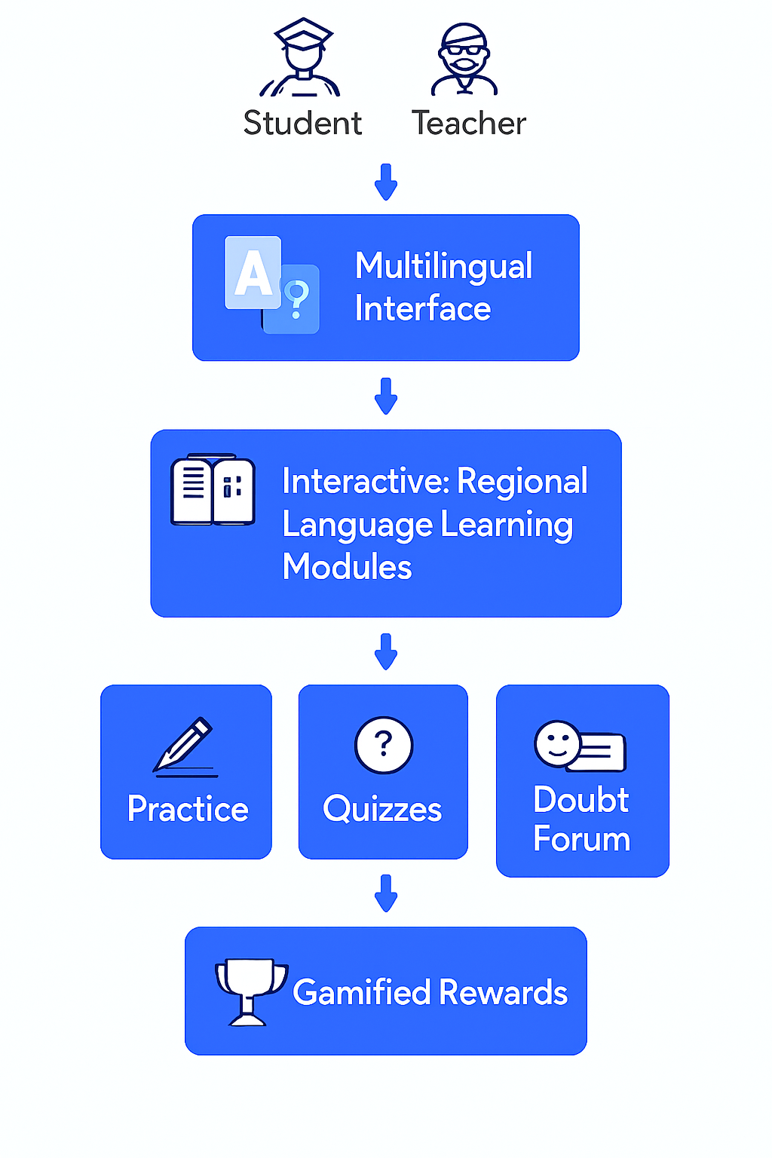
Navi Kalam
is a web-based digital learning platform designed to make education more engaging, accessible, and interactive for students and teachers
Challenges Faced by Rural Students
Old Infrastructure – Few working computer labs, outdated devices.
Poor Internet – Frequent outages, slow speed.
Low Digital Skills – Students lack basic computer knowledge.
Untrained Teachers – Limited exposure to digital teaching methods.
Device Issues – Shared low-end phones, no offline-friendly apps.
No Progress Tracking – Hard to monitor student performance.
Proposed Solution:
A progressive web app for students & teachers enabling interactive learning in regional languages.
Supports multilingual interface (English, Hindi, Punjabi).
Includes learning modules, practice tools, quizzes, doubt forum, and gamified rewards.
How it Addresses the Problem:
Provides equal access to education regardless of location or resources.
Encourages students with gamification & streaks.
Helps teachers track progress and guide students better
(Describe your Idea/Solution/Prototype)
Detailed explanation of the proposed solution
How it addresses the problem
Innovation and uniqueness of the solution

Slide 3
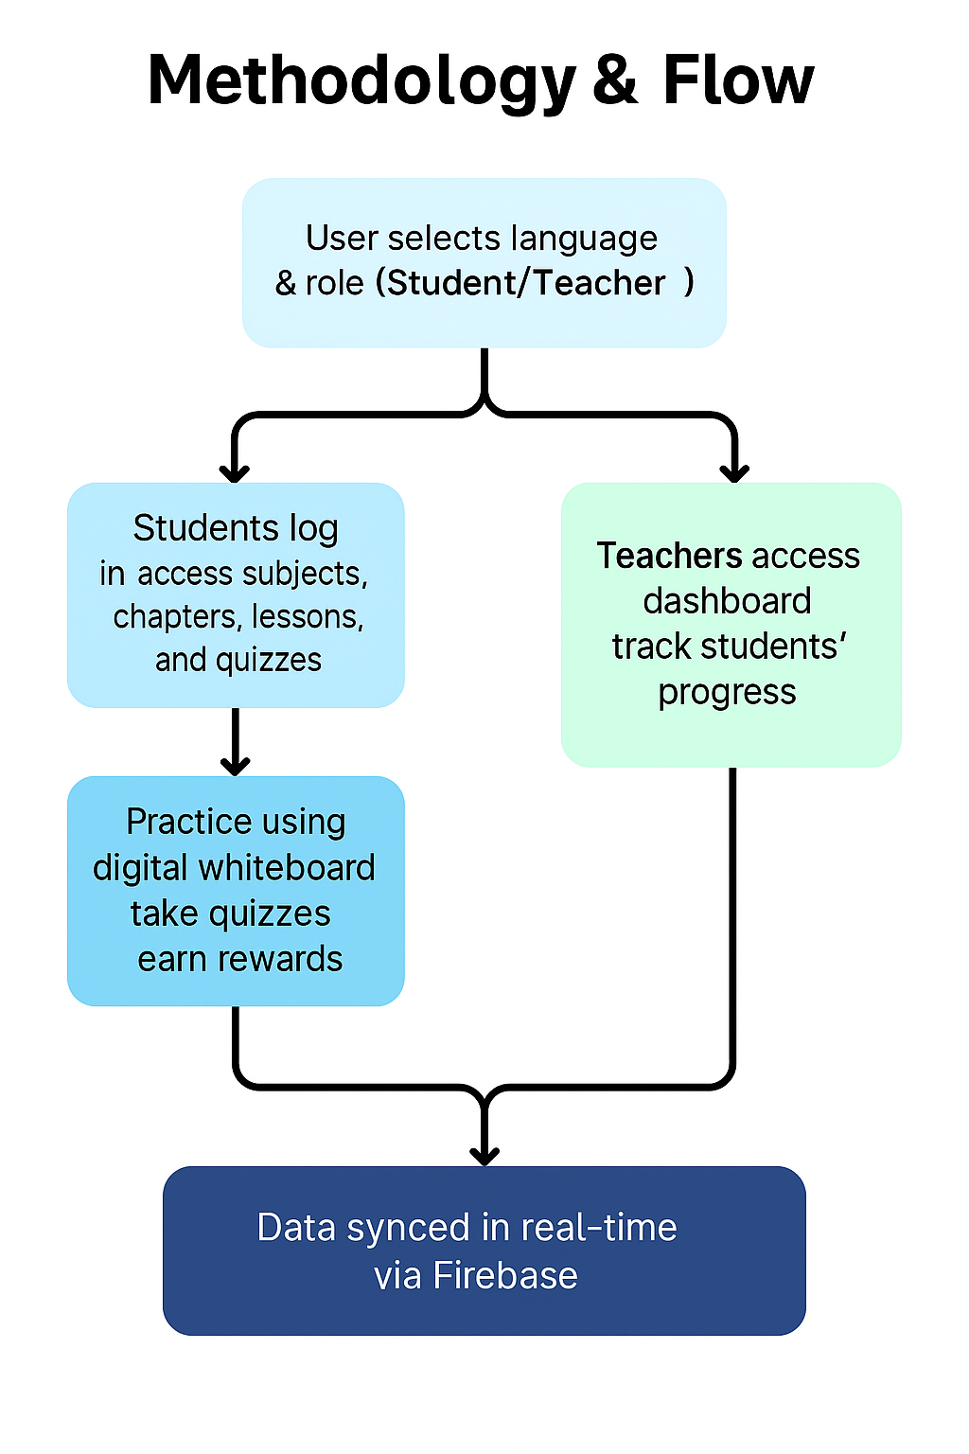
TECHNICAL APPROACH
Your Team Name

Slide 4
Features
of This app
Your Team Name
Feasibility & Viability
Main App Navigation
Home: Shows today’s focus, subject progress, and showcase section.
Learn: Subject-wise learning map → Chapter selection → Lesson view.
Practice: Digital Whiteboard (pen, eraser, undo, save).
Object Explorer (camera-based object recognition — placeholder).
Rewards: Total points, badges, class leaderboard.Profile: Avatar selection & profile details.
Settings: Dark theme toggle, change language.
Offline Manager: Shows cached subjects for offline access.
Teacher DashboardDisplays all students with progress bars and color indicators (green/red).Calculates average progress automatically.Click on a student to see detailed subject-wise performance.
Teacher Dashboard
Displays all students with progress bars and color indicators (green/red).
Calculates average progress automatically.
Click on a student to see detailed subject-wise performance.
Lessons & Quizzes
Tabbed Lessons: Lesson → Summary → Quiz in a single screen.
Quizzes:
Immediate feedback (correct/incorrect).
Confetti animation + challenge friend button on correct answers.
Technical Feasibility
Offline-first architecture → ensures accessibility in low-connectivity rural regions.
Lightweight design → optimized for low-end devices (≤2GB RAM smartphones).
Cross-platform development → mobile + web app for wider reach.
Content modularity → scalable to add state-specific curricula or skill modules.
Operational Feasibility
Ease of use → simple UI/UX tailored for first-time digital learners.
Teacher adoption → dashboards and training modules integrated for educators.
Local language support → ensures inclusivity and higher engagement.
Maintenance plan → periodic updates via small offline/online patches.
Economic Viability
Low-cost deployment → mobile-first strategy avoids dependency on expensive hardware.
Open-source / cloud integration → reduces infrastructure costs.
Sponsorship/CSR potential → aligns with government & NGO educational goals.
Scalability → one-time development, reusable across multiple districts.
Social Viability
Bridges digital divide → rural students gain equal opportunities as urban peers.
Community impact → parents, teachers, and students connected via shared platform.
Motivation & retention → gamification + community showcase boosts learning outcomes.

Slide 5
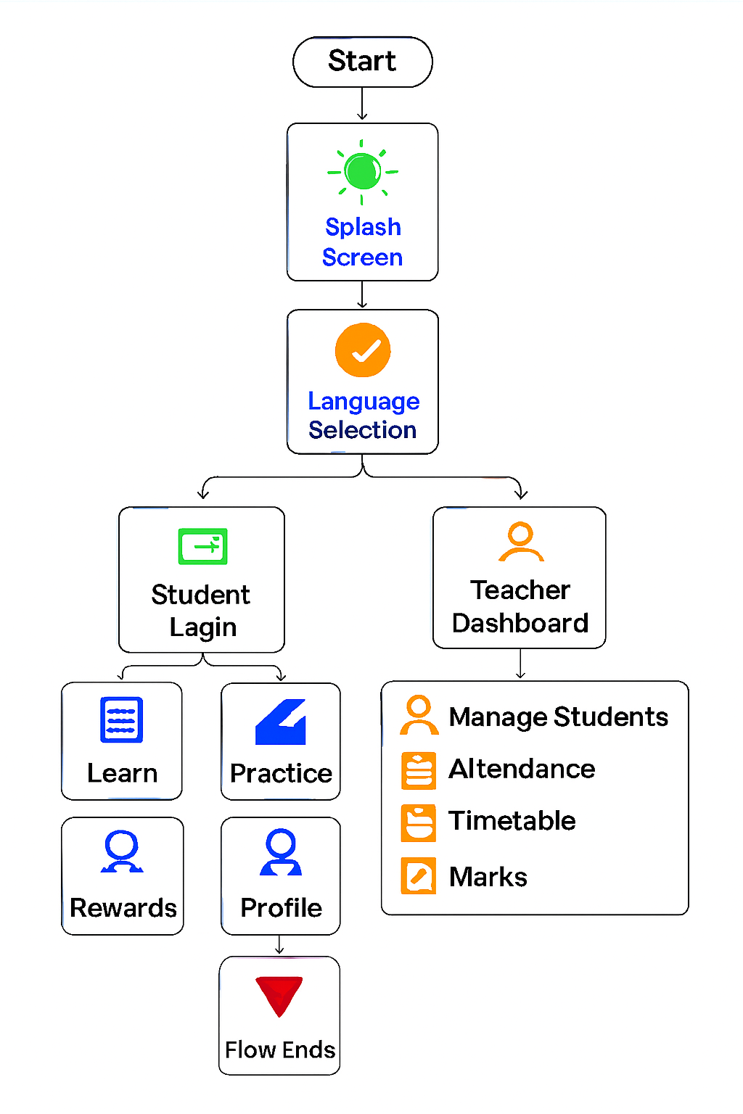
IMPACT AND BENEFITS
Your Team Name
Social Benefits
📚Inclusive Learning – Multilingual support (English, Hindi, Punjabi) allows students from different backgrounds to learn easily.
👨‍👩‍👧‍👦 Parent & Teacher Collaboration – Attendance, marks, and student progress tracking strengthen communication between teachers and parents.
🎯 Equal Opportunity – Rural and urban students get the same high-quality resources.
🤝 Community Engagement – Doubt forum and community showcase encourage peer-to-peer learning.
Potential Impact on Target Audience
🎓 Students – More engaged, interactive, gamified learning experience → better understanding & retention.
👩‍🏫 Teachers – Save time on admin tasks, focus more on teaching.
👨‍👩‍👧 Parents – Stay updated with real-time progress & attendance data.
📈 Schools/Education System – Improved results, reduced dropout rates, measurable performance analytics.
Economic Benefits
💰 Low-Cost Implementation – Works as a web app (no expensive hardware required).
🏫 Scalable Solution – Can be deployed in multiple schools without extra cost.
🖥 Paperless Workflow – Reduces cost of printing timetables, report cards, and attendance sheets.
📈 Better Learning Outcomes – Improved student performance reduces long-term remedial costs.
Environmental Benefits
🌱 Paperless Education – Digital notes, report cards, attendance reduce paper usage.
🔋 Energy Efficient – Lightweight app uses fewer resources, works on low-end devices.
🚯 Reduced Waste – No physical distribution of worksheets, saving resources.

Slide 6
RESEARCH AND REFERENCES
Your Team Name
Details / Links of the reference and research work

